Slide 1


Migrate. Innovate. Enable
Unlock the full power of Azure
Company Profile
Website: www.snp.com
Contact Email: sales@snp.com

Slide 2

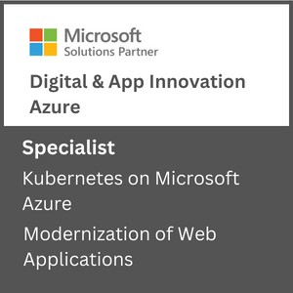
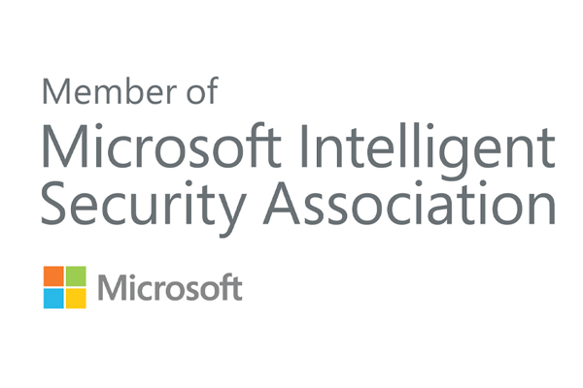
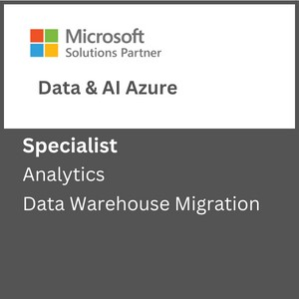
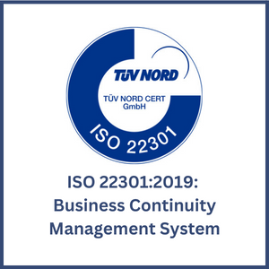
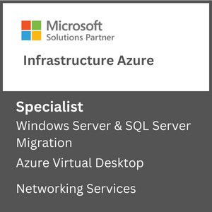
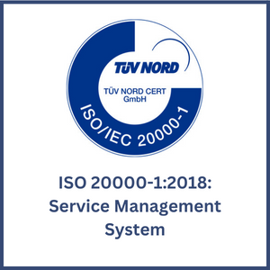

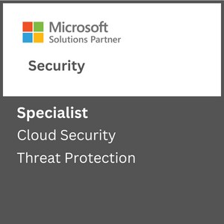
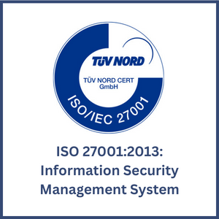

About SNP
Driving Innovation & Business Excellence with Microsoft Azure in:
SNP transforms businesses with innovative, cloud-based solutions that harness the power of Microsoft Azure. We are 100% Azure focused, 100% SMC focused and 100% certified for different Microsoft funding programs like ECIF, Azure Innovate and AMM.
SECURITY
Defend Against Threats with SIEM Plus XDR
Secure Multi Cloud Environments
Secure Identities and Access
Protect and Govern Sensitive Data
Mitigate Compliance and Privacy Risks
DevSec Ops
MICROSOFT ADVANCED
SPECIALIZATIONS
APPS & INFRASTRUCTURE
Migrate and Modernize Your Infrastructure and Workloads - WS/SQL on Azure; Linux/OSS DB on Azure; AVS; AVD
Protect Your Data and Ensure Business Resiliency with BCDR- Azure Backup, Azure Site Recovery, BCDR Solutions
ANALYTICS ON MICROSOFT AZURE
NETWORKING SERVICES
AZURE VIRTUAL DESKTOPS
KUBERNETES ON MICROSOFT AZURE
Migrate enterprise apps to Microsoft azure
INFRA & DATABASE MIGRATION TO MICROSOFT AZURE
CLOUD SECURITY
THREAT PROTECTION
DATA WAREHOUSE MIGRATION
Modernize Your Workloads with Azure at any Scale with HPC plus AI- Azure specialized VMs, Azure Cycle/Batch, Storage Services, Networking Services.
Innovate Across Hybrid and Edge with Azure Arc- Azure Arc, Arc-enabled data and ML, AKS, Microsoft Defender, Azure Monitor ,Azure Stack HCI
ISO Certifications:
DevOps on Azure: DevOps Maturity Model, CI/CD, IaaC, DevSecOps
DATA, ANALYTICS & AI
Innovate with AI and Cloud Scale Databases in Every App- Azure Cognitive Services, Azure Applied AI Services, Azure Cosmos DB, Azure MySQL & PostgreSQL, Azure SQL DB, Azure ML
Migrate and Modernize Your Data Estate- Azure SQL MI, Azure SQL IaaS, Azure Arc Data, Azure Cosmos DB, Azure PostgreSQL​, Azure MySQL
MICROSOFT PARTNER AWARDS
Power Business Decisions with Cloud Scale Analytics- Azure Synapse, Azure ML, Azure Databricks & PBI
Enable Unified Data Governance- With Microsoft Purview get unified data governance across on-premises, multi-cloud, and SaaS environments
DIGITAL & APPLICATION INNOVATION
2023 PARTNER OF THE YEAR
FINALIST
Security
Modernize Enterprise Applications- Azure App Service , Azure Spring Cloud, API Management, Logic Apps, Power Apps, AKS
Innovate and Scale with Cloud Native Apps - AKS, Azure Functions, Azure Container Apps, Azure DB for PostgreSQL, Azure Cosmos DB, Azure Arc
2021 MSUS PARTNER OF THE YEAR WINNER
Business Excellence in Solution Assessments
Enable Developer Productivity and Accelerate Delivery- Power Apps, Power Automate
Accelerate Innovation with Low Code- GitHub, Visual Studio
AZURE MANAGED SERVICES
2019 MSUS PARTNER OF THE YEAR WINNER
Intelligent Cloud & OSS on Azure
Support Desk Operations
Managed Azure Infrastructure Operations
Managed Security Operations
Managed App Services and Kubernetes.
Optimization Services
Managed DR & Backup Operations
Managed Data Operations
Managed DevOps Services
2019 PARTNER OF THE YEAR FINALIST
Open-Source Applications & Infrastructure on Azure
CSP SERVICES
Licensing Support
Azure Billing Support
Azure Service Health Support
FinOps as an Add on Support

Slide 3

Key Focus Areas
Recent Projects
Artificial Intelligence & Machine Learning
Data Engineering Services
Database Modernization
MLOps
Solution Architecture & Consulting Services
Business Intelligence & Visualization Services
Power Bi with Synapse Analytics
Data Platform in 30 Days
Data Integration Services
Enterprise DW Modernization
Data Integration Services
ML Model Building & Consulting
ML Platform Operationalization (MLOps)
SQL Server Modernization with Azure PaaS
Power BI Governance
Power BI Development
Data, AI & Analytics
Migrate and transform data for data driven customers using solutions such as data engineering, BI and AI
Apps & Infrastructure
Hybrid Cloud
Hybrid Security Rationalization & Strategy
Cloud Infrastructure & Management
Hybrid Cloud Strategy with Azure Arc
App Innovation
DevOps & GitOps Solutions
Open-Source Solutions
Hybrid Identity
API Management
Infrastructure Rationalization & Migration Roadmap design
Servers Lift & Shift
OSS & SQL Migration to PaaS
Citrix Virtual Desktops
Windows Virtual Desktops
Hybrid Cloud Framework
Hybrid Management with Azure Arc
Compliance Policy as a Code
Hybrid Security Rationalization
.NET – Application Modernization with Azure PaaS
OSS - Application Modernization with Containers & Azure PaaS
AKS Maturity Model
Kubernetes & Containers
Red Hat Cloud Solutions
DR & Cloud Failover
Azure Sentinel & SIEM Integration
Azure Sentinel - Workflow & Connectors development
End-to-end cloud solutions which include infrastructure and operations, DevOps and automation and application modernization
Azure Managed Services
CSP Hosting Services
Support Desk Operations
Managed Azure Infrastructure Operations
Managed Disaster Recovery & Backup Operations
Virtual Desktop Infrastructure –(VDI) Operations
Managed Data Platform Operations
Managed DevOps Services
Managed Security Operations
Managed VDI Operations (Citrix & Windows VDI)
Premium Managed Services
Azure Managed Services supporting the full Microsoft Azure solution suite including infrastructure, data, security, DevOps and more
Industries We Serve
Healthcare
Biotech
Financial Services
Manufacturing
Professional Services
Engineering & Architecture

Slide 4
AGENDA
SIEM
SOAR
Prerequisites for Sentinel Deployment
Design Considerations of Sentinel
Data Collection to Sentinel
Log Pricing
4

Slide 5
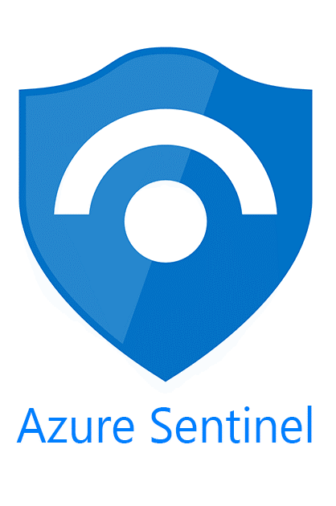
Microsoft Sentinel
Sentinel is a cloud native SIEM and SOAR
Security Information and Event Management.
Security Orchestration Automation and Response.
SIEM - collect data from all the sources including on-premises and other cloud providers and analyze it using threat intelligence and advances analytics.
SOAR - allows to automate and orchestrate common tasks and workloads using built-in or custom playbooks.
Notes:
- gateway types

Slide 6
Prerequisites and Roles
A Microsoft Entra ID license and tenant.
An Azure Subscription.
A Log-Analytic workspace.
You need to have at least contributor role at subscription level to enable Sentinel.
You need to have Contributor or reader role at resource group where workspace belongs to live.
Sentinel Reader – Can view incidents, workbooks other M Sentinel resources.
Sentinel Responder – Can manage incidents (assign, dismiss etc.)
Sentinel Contributor – Can create and edit analytic rules and Sentinel resources.
Sentinel Contributor + Logic App Contributor – Can create and run playbooks.
Notes:
- gateway types

Slide 7
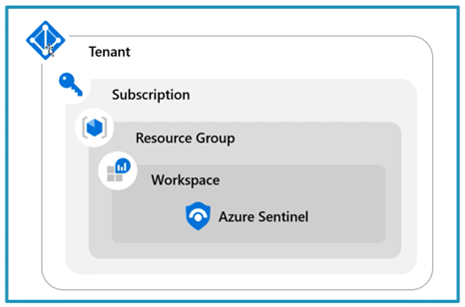
Design Considerations of Deployment
Pros | Cons
Central pane of Glass | May not meet governance requirements
Consolidation of logs | Can incur bandwidth cost between regions
Easier to query information
Log analytic RBAC to control access
1. Single tenant with single Sentinel Workspace

Slide 8
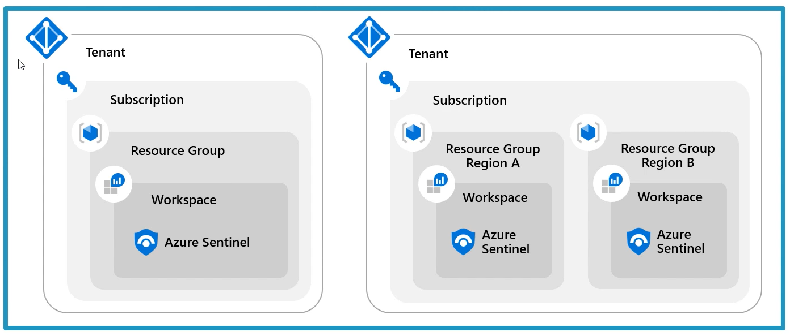
2. Single tenant with regional Microsoft Sentinel Workspace
Pros | Cons
No Cross-region bandwidth cost | No Central pane of Glass
May be required to meet governance | Analytics, workbooks etc must be deployed multiple times
Granular data access control
Granular retention settings
Split Billing

Slide 9
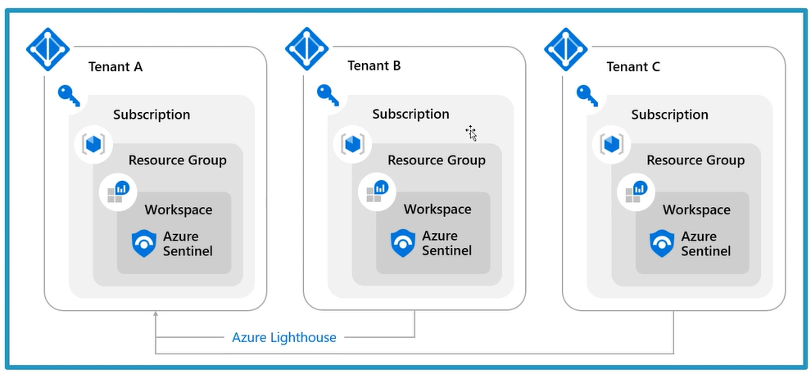
3. Multi-tenant
Multi-tenant workspaces using Azure Lighthouse.
Lighthouse helps you manage resources between multiple customers.

Slide 10
Types of Logs
Analytic logs
High value security logs.
Two ways of pricing
Pay-as-you-go.
Pay-as-you-go pricing is $4.30 per GB-ingested.
Commitment Tires
Starts from 100 GB per day to 50,000 GB per day. Beyond the limit will be billed with discount cost.
Can opt out of the commitment tier any time after the first 31 days of commitment.
Commitment tire for 100GB with 31% discount on per GB is $2.96 per GB.
Basic logs
Verbose of low security value data with $1.00 per GB-ingested.
Notes:
The commitment tiers will have 31 days of commitment period from the time a commitment period is selected.
You can change to the higher commitment tiers during this period but not to lower tiers.
You cannot move back to pay-as-you-go until you cross the commitment period.
After the commitment period, workspace retains the commitment tiers, and we can change it to lower tiers or else move back to pay-as-you-go.

Slide 11
Commitment tiers
Tier | Microsoft Sentinel Price | Effective Per GB Price¹ | Savings Over Pay-As-You-Go
Pay-As-You-Go | $4.30 per GB | $4.30 per GB | N/A
100 GB per day | $296 per day | $2.96 per GB | 31%
200 GB per day | $548 per day | $2.74 per GB | 36%
300 GB per day | $800 per day | $2.67 per GB | 38%
400 GB per day | $1,037.33 per day | $2.60 per GB | 40%
500 GB per day | $1,265 per day | $2.53 per GB | 41%
1,000 GB per day | $2,480 per day | $2.48 per GB | 42%
2,000 GB per day | $4,800 per day | $2.40 per GB | 44%
5,000 GB per day | $11,550 per day | $2.31 per GB | 46%
10,000 GB per day | $22,240 per day | $2.23 per GB | 48%
25,000 GB per day | $53,450 per day | $2.14 per GB | 50%
50,000 GB per day | $1,02,600 per day | $2.06 per GB | 52%

Slide 12
Retention period of tables
Total retention period = Interactive retention period + Archival retention period.
Interactive retention period - This is the period of 4 days to 2 years. This is the period where you can retain data for interactive queries.
Archive retention period - This is the period up to 12 Years. This period is for the data to be accessible less frequently.
Archival cost per GB is $0.02
The Archival data can be retrieved only via search jobs or restore.

Slide 13
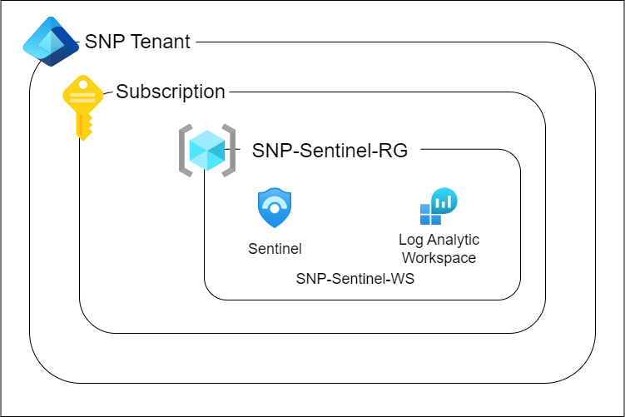
SNP Sentinel Instance – GAP report
Architecture

Slide 14
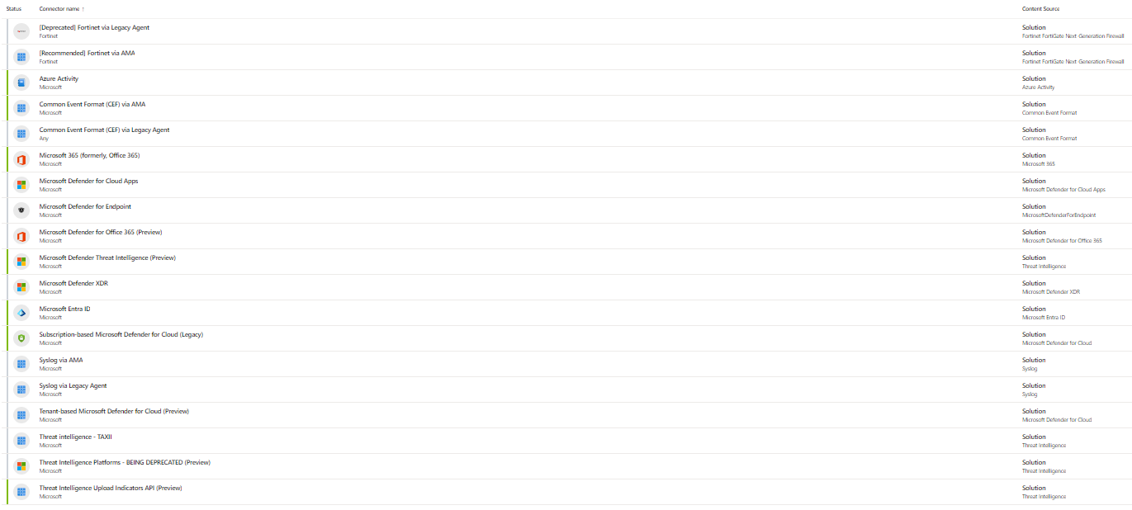
Data Connectors

Slide 15
Data Connectors
My Recommendation
Microsoft Defender XDR solution includes all the below individual connectors.
Microsoft Defender for Endpoint
Microsoft Defender for Office 365
Microsoft Defender for Cloud Apps
Microsoft Defender for Identity
Incident management should be done individually from both sides (Defender portal and Azure portal)
The newer Microsoft Defender XDR connector removes the limitations and should be used instead of the legacy connectors.

Slide 16
Sentinel Usage

Slide 17

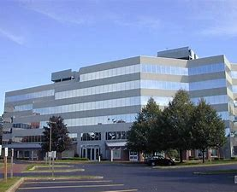

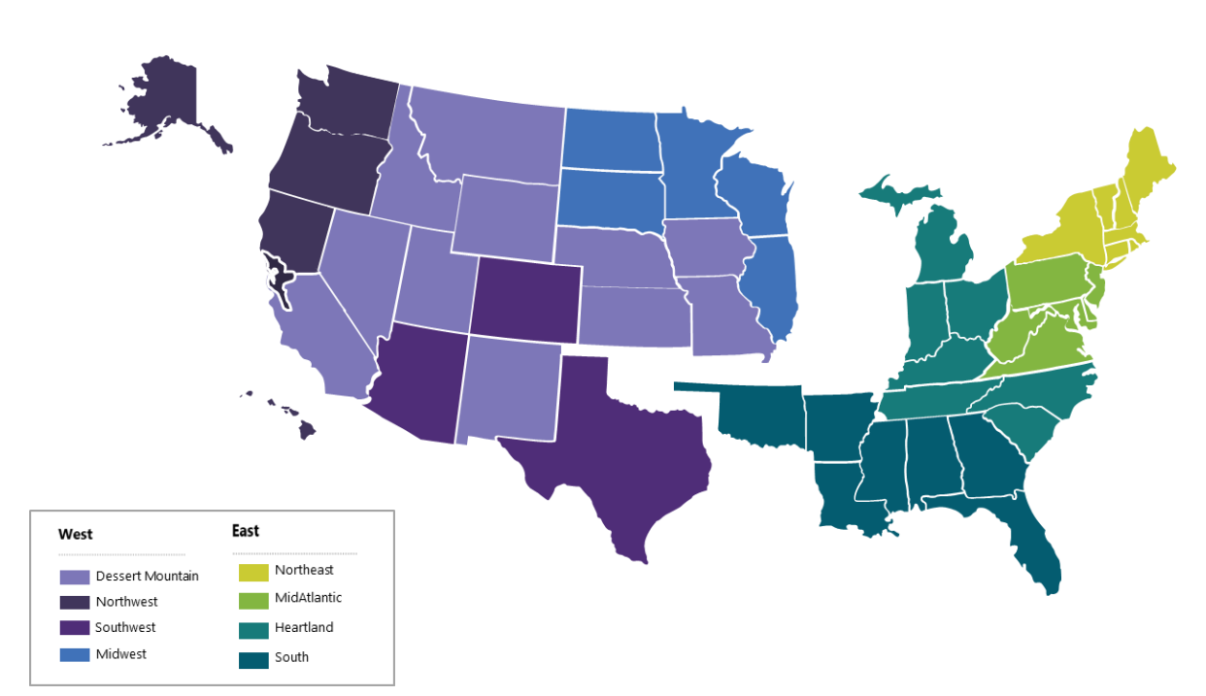

Contact Us:
Company Headquarters
SNP Technologies, 2319 Whitney Avenue, Suite 3C Hamden, CT 06518-3535,
(203) 287-9114
Sachin Parikh
VP of Business Development
sachin@snp.com
203-287-9114 X 112
Phil Balogh
Director Sales- North -USA
phil@snp.com
203-228-0310
Emerging/Investment
Market
Established
Market
Michael Fiorito
Director Sales- South- USA
Michael.fiorito@snp.com
917-753-0346
100% focused in SMC

Slide 18


www.snp.com
2319 Whitney Ave. | Suite 3C | Hamden, CT 06518

